Slide 1

Sports Analytics I
Produced by Dr. Mario
UNC STOR 538

Slide 2
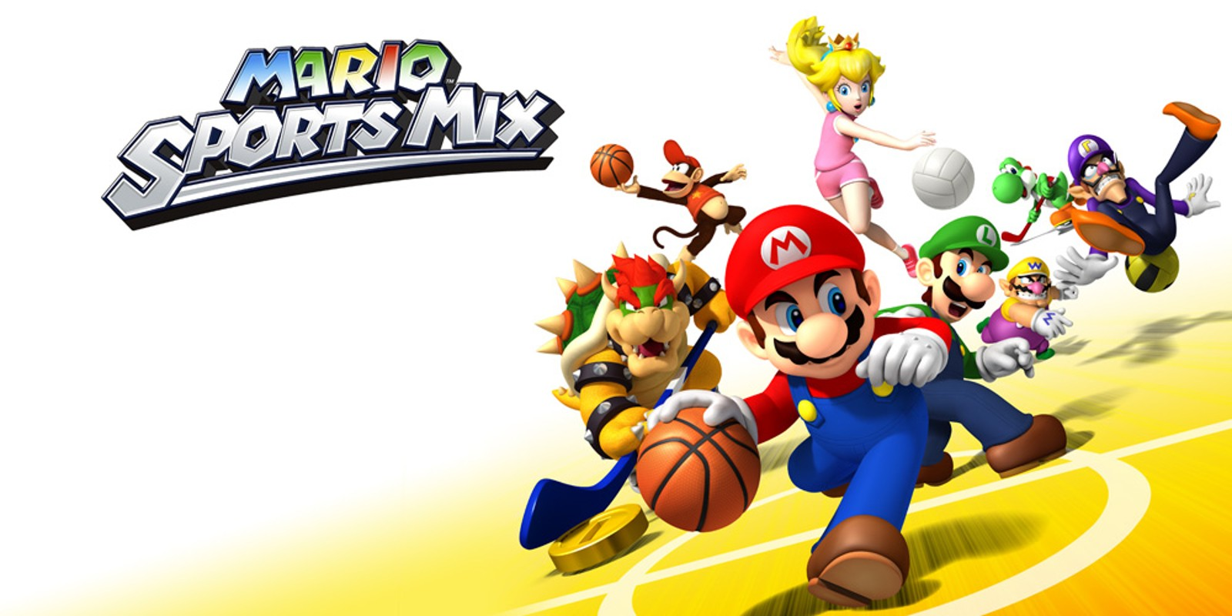
Survey on Sports
Complete the …
Survey

Slide 3
Survey Results: Demographics
75 Responses (Thank You!!)
Majority are Seniors (43/75)
Others are Juniors (25/75)
Some are Sophomores (6/75)
Other = 1

Slide 4
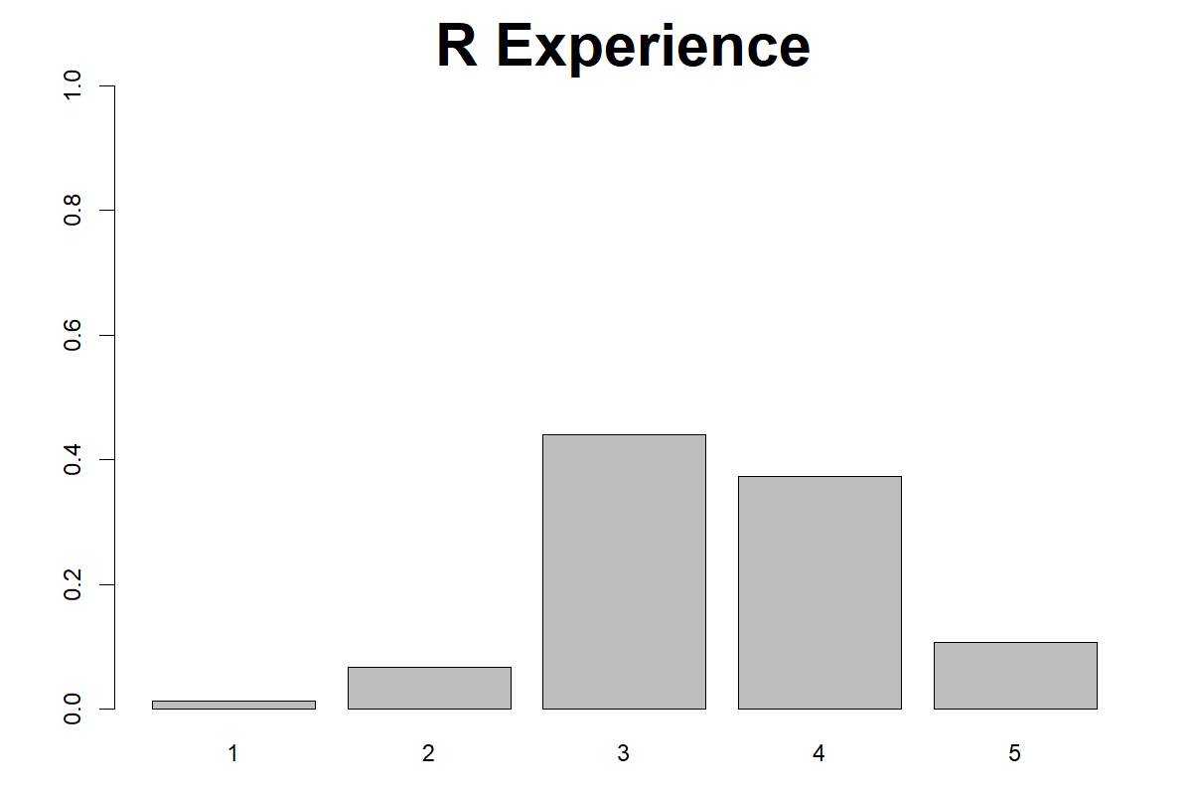
Survey Results: R Experience

Slide 5
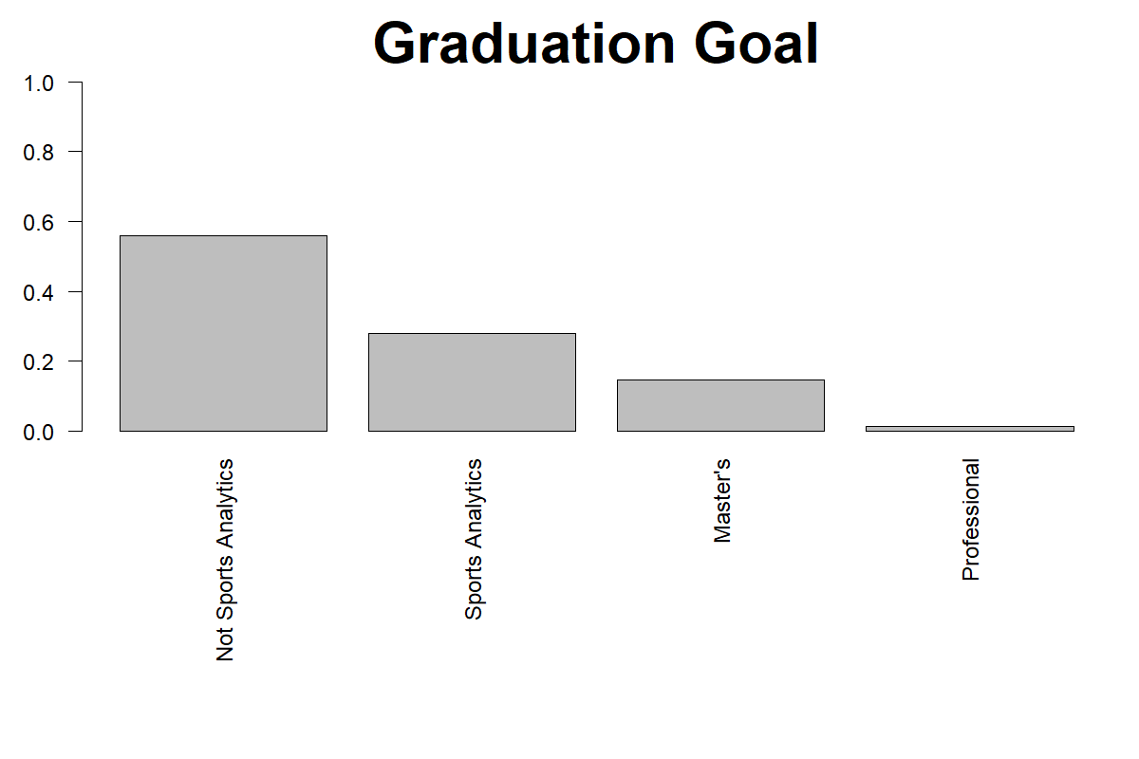
Survey Results: Goal After Graduation

Slide 6
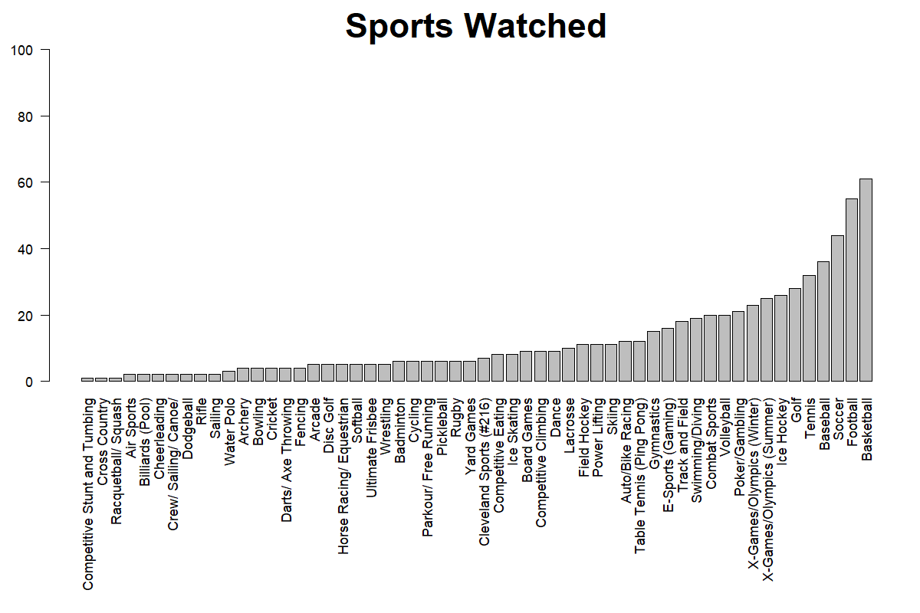
Survey Results: Watched
56 Unique Sports Represented

Slide 7
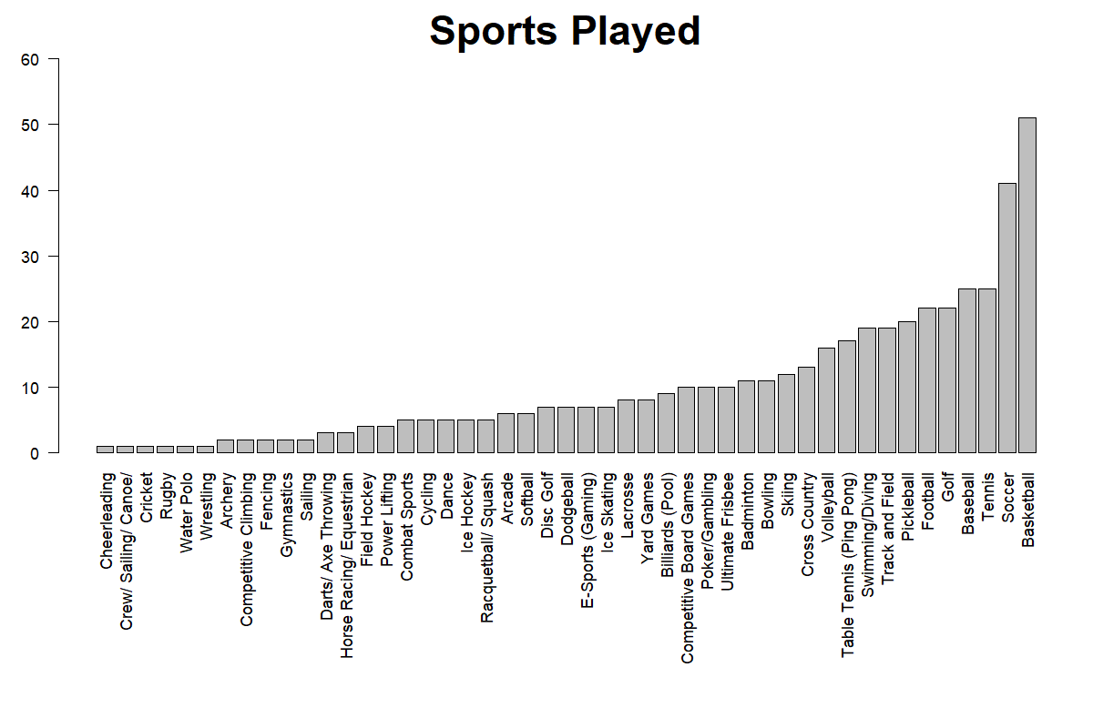
Survey Results: Played
47 Unique Sports Represented

Slide 8
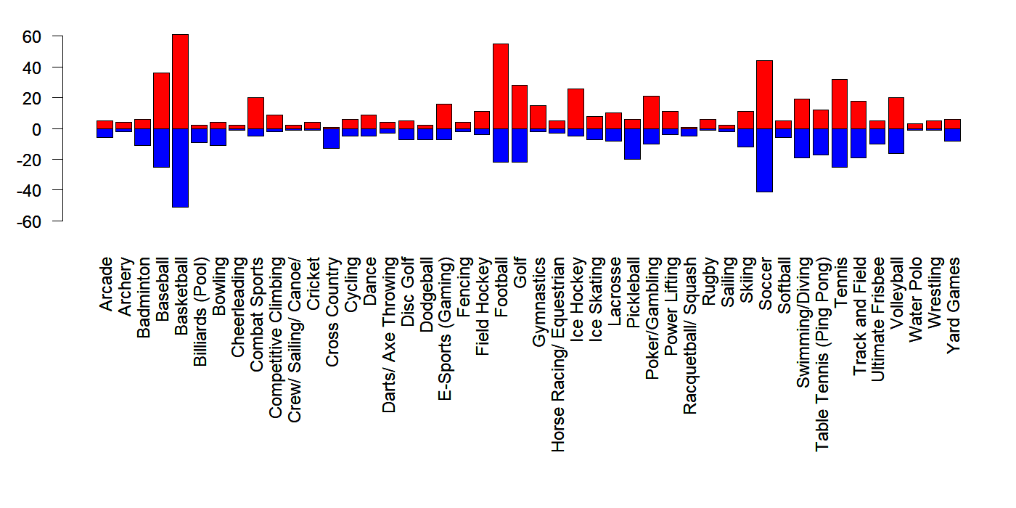
Survey Results: Combined
Watched = Red
Played = Blue

Slide 9
Current Landscape of Sports
Most Popular World Sports (hdled.com)
“Ranked Based Off Global Popularity, Media Coverage, and Cultural Significance”
From Most Popular to Least Popular
Soccer
Cricket
Basketball
Tennis
Hockey (Field and Ice)
American Football
Baseball
Golf
Table Tennis
Volleyball

Slide 10
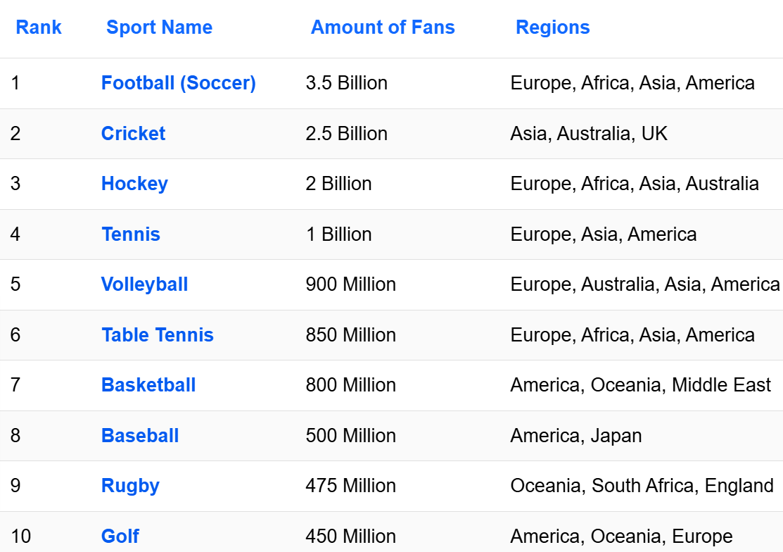
Current Landscape of Sports
Most Popular World Sports (worldatlas.com)
Based on Number of Fans

Slide 11
Current Landscape of Sports
Most Popular World Sports (biggestglobalsports.com)
Ranking of Top 5
Football
Basketball
Tennis
Cricket
Baseball
Gives Rationale for Metric But No Formula
Discusses Data Without Providing the Data or Preview of Data

Slide 12
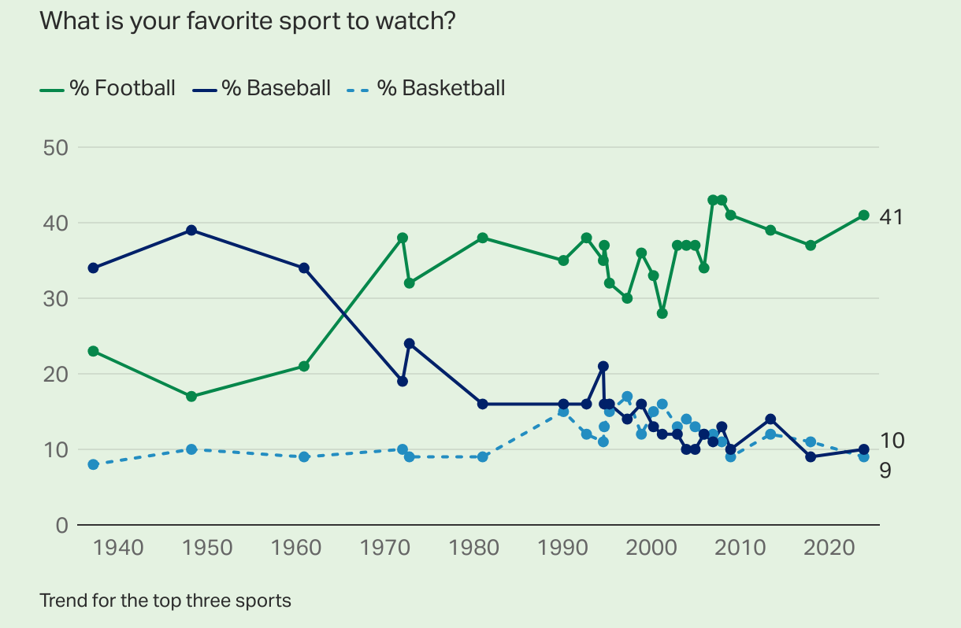
Current Landscape of Sports
Most Popular US Sports (Gallup.com)
41% of US Adults Say Football is “Favorite”
Football has been “Favorite” Since 1972
Not True with Young Adults (Basketball)
Soccer is Interesting
<2% Prior to 2004
Consistently Above 2% Since 2008 (High of 7%)
Updated to 2024

Slide 13
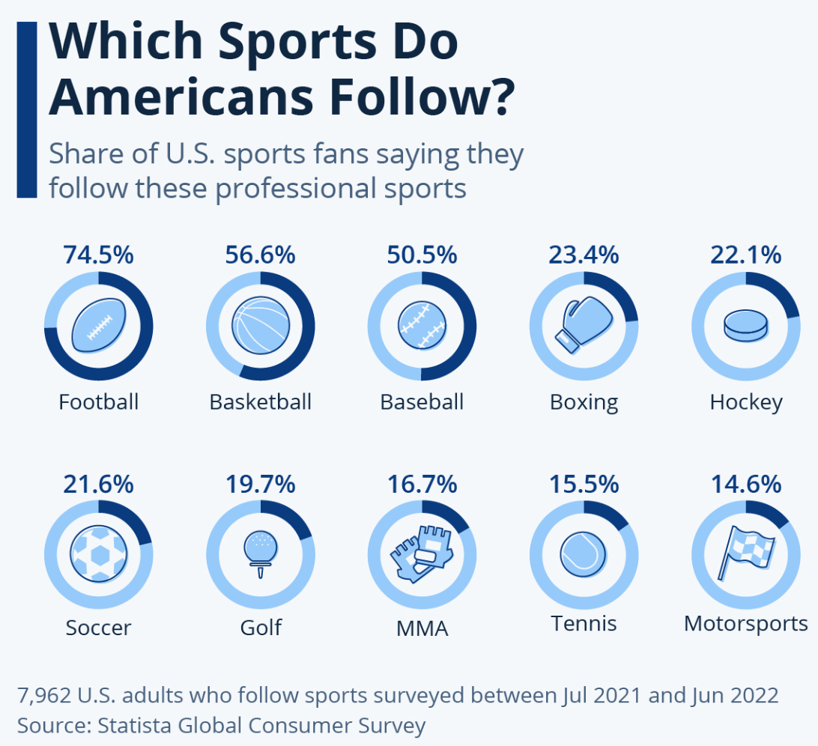
Current Landscape of Sports
Infographic About US Sports (Statista.com)

Slide 14
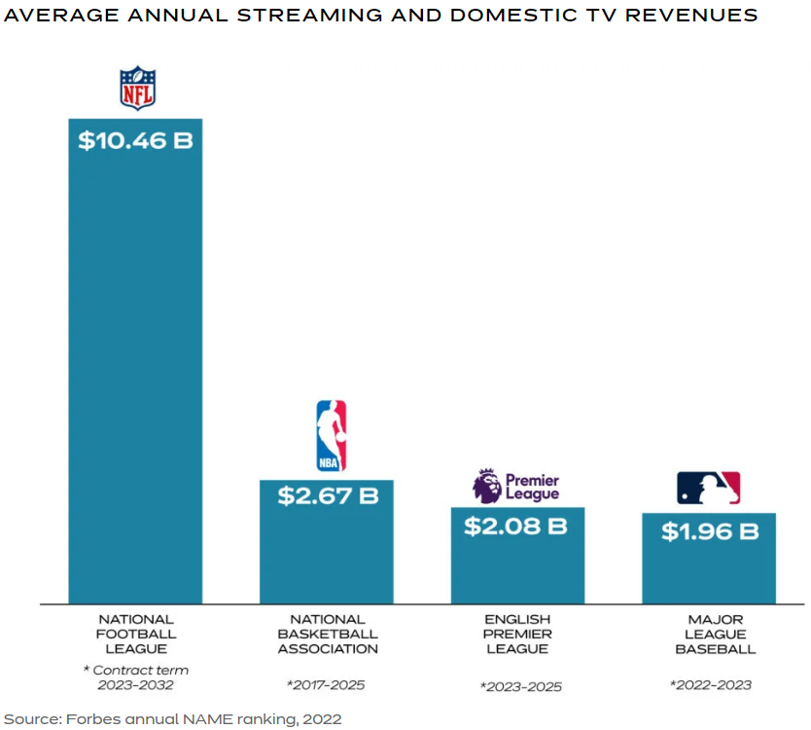
Current Landscape of Sports
Revenue in Sports Leagues (Forbes 2022)

Slide 15
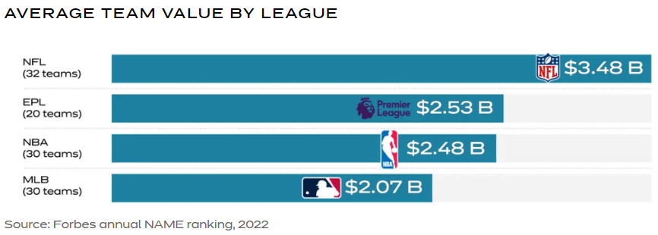
Current Landscape of Sports
Revenue in Sports Leagues (Forbes 2022)

Slide 16
Current Landscape of Sports
Revenue in Sports Leagues (Wikipedia)
List Based off Most Recent Data (in Euro)
NFL (American Football,18.027 Billion)
MLB (Baseball, 10.07 Billion)
NBA (Basketball, 9.951 Billion)
EPL (Soccer, 6.442 Billion, England)
NHL (Hockey, 1.4 Billion)
La Liga (Soccer, 4.443 Billion, Spain)
Bundesliga (Soccer, 3.610 Billion, Germany)
Serie A (Soccer, 2.927 Billion, Italy)
Ligue 1 (Soccer, 2.407 Billion, France)
NPB (Baseball, 1.506 Billion, Japan)
Compare Revenue Per Team and Revenue Per Match

Slide 17
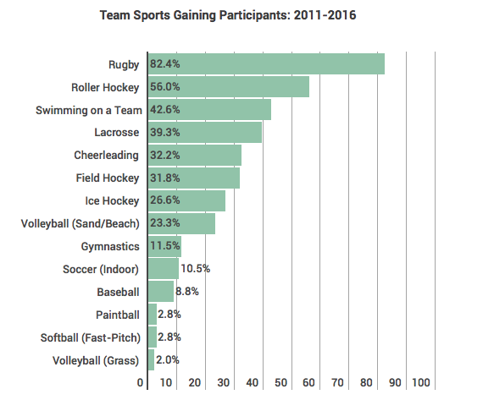
Current Landscape of Sports
Growth in Team Sports (sisugaurd.com)
Based on 2017 Annual Report
On US Trends in Team Sports
By Sports & Fitness Industry Association (SFIA)

Slide 18
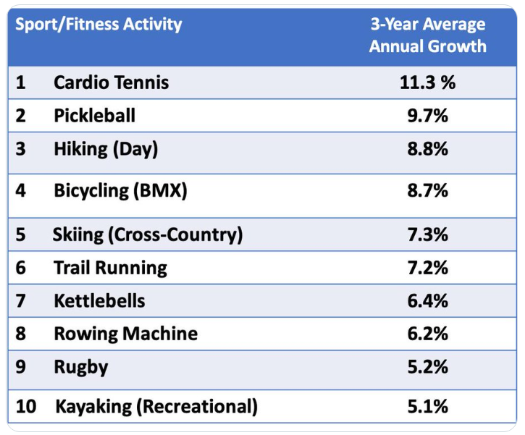
Current Landscape of Sports
Growth in Team Sports (SFIA Twitter)
Based off 2019 Report

Slide 19
Current Landscape of Sports
Growth in Team Sports (SFIA)
Interesting Information About 2022 Annual Report
Pandemic Effect on Team Sports
67 million in 2020 to 68.3 million in 2021
70.8 million in 2019
Team Sports Ages 6-12 Increased 0.6 million in 2021
Basketball Continues to be Most Played (27.1 million)
Soccer Overtook Basketball for 6-year-olds in 2021

Slide 20
Current Landscape of Sports
Growth in Team Sports (SFIA)
Participant Rate Changes
Fast-Pitch Softball (+15.3%)
Gymnastics (+10.9%)
Court Volleyball (+8.1%)
Swimming on Team (+8%)
Team Sports Increased by 8 Million from 2022 to 2023
Sport Per Participant Continues a Downward Trend
Mean = 1.73 (Lowest in the Decade)

Slide 21
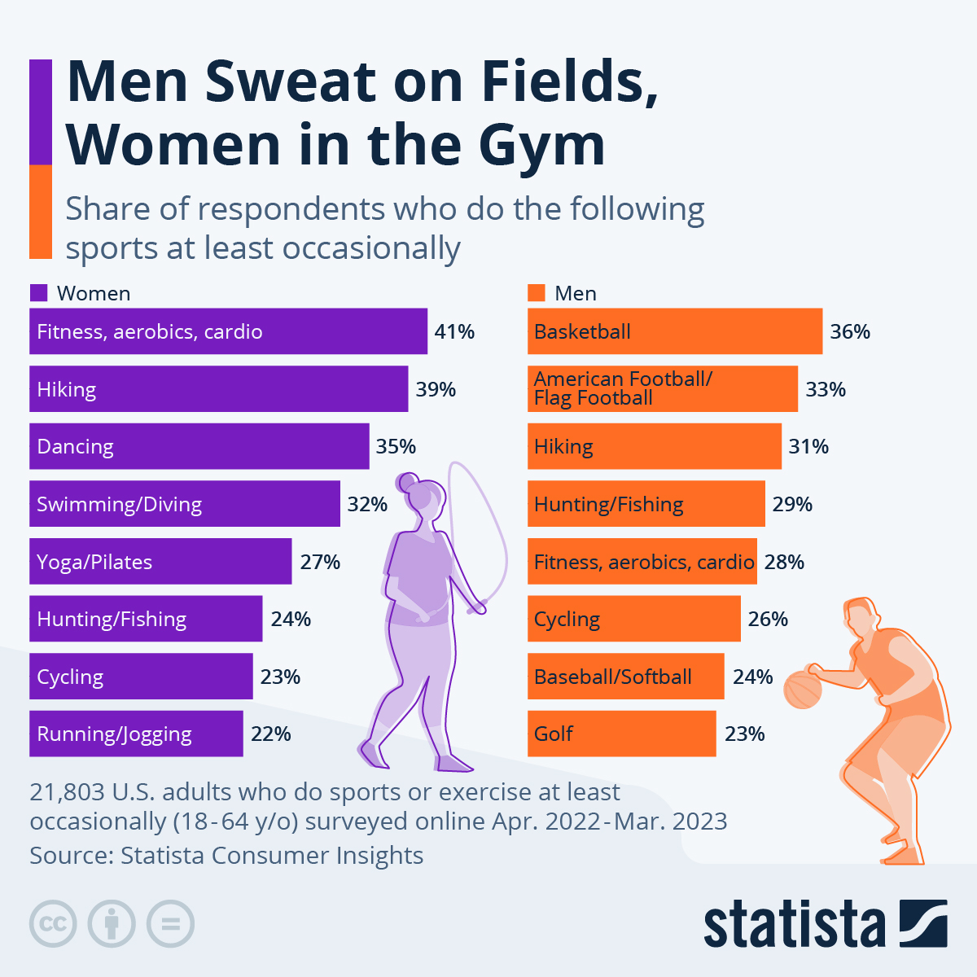
Current Landscape of Sports
Article by Florian Zandt (Statista.com)
96% of Americans Spent Time on Sports and Leisure Activities in 2021 (US BLS)
Number Consistent Along the Gender Divide
Article Focuses on Differences Between Men and Women Respondents

Slide 22
Dope Quote
The most meaningful way to
differentiate your company from your
competitors, the best way to put distance
between you and the crowd is to do an
outstanding job with information.
How you gather, manage, and use information
will determine whether you win or lose.
- Bill Gates

Slide 23

What is Sports Analytics?
Defined by Ben Alamar
Data Management
Predictive Models
Information Systems
Data
Management
Information
Systems
Analytic Models
Decision Maker
Based on Sports Analytics by Ben Alamar

Slide 24
What is Sports Analytics?
Purpose: To Aid an Organization’s Decision Makers in Gaining a Competitive Advantage
Goals
Save the Decision Maker Time by Making Information Acquisition Efficient
(Data Management/Information Systems)
Provide Decision Makers with Novel Insight
(Analytic Models)
We are an Accessory to the Decision Maker

Slide 25
What is Sports Analytics?
Different Decision Makers
Off-the-Field: Profit Driven
On-the-Field: Performance Driven
Attributes of the Data Analyst
Competence – Ben Alamar
Leadership – Ben Alamar
Humility – Dr. Mario
Honesty – Dr. Mario

Slide 26
Final Inspiration
If you’re not first, you’re Cleveland. #216
- Mahatma Mario

